Slide 1
Helping Hands
By:
Anusha Malla
Briana Jenkins
Daniel Bae
Haythem Abdelkhalek
Trmnit Tesfatsion
Wonjin (James) Choi

Slide 2
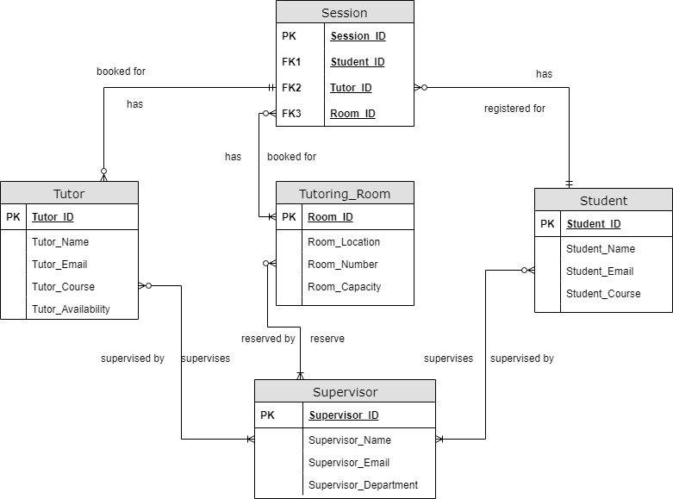
ERD

Slide 3
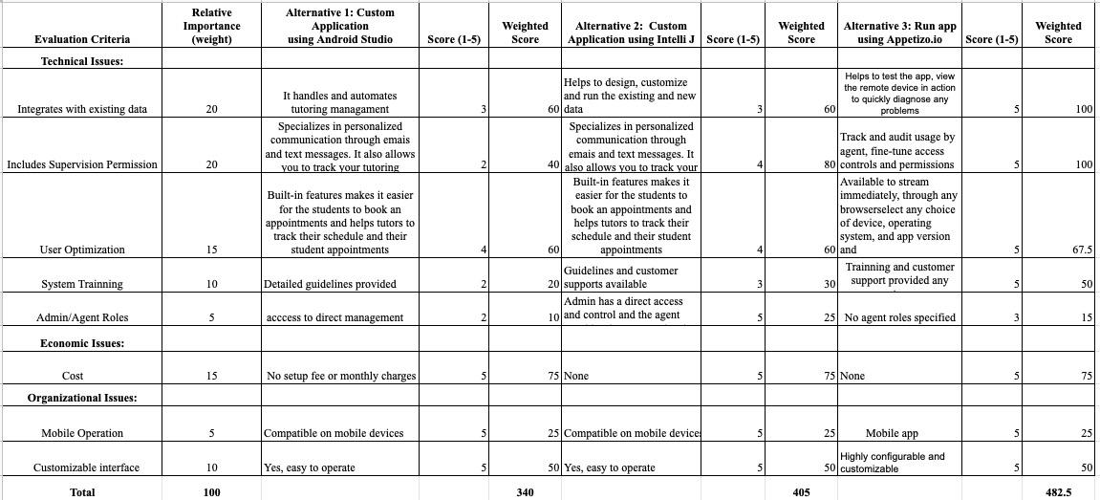
Team’s Alternative Matrix

Slide 4
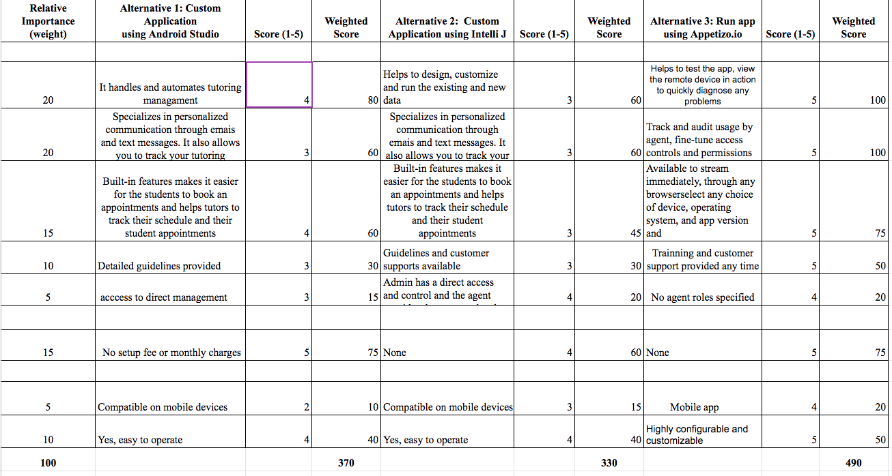
Anusha’s Alternative Matrix

Slide 5
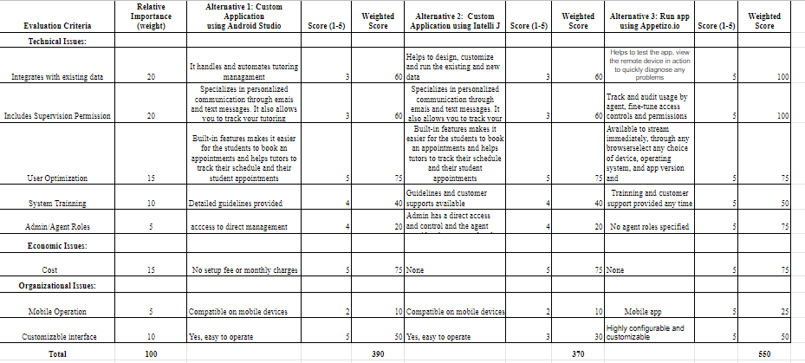
Briana’s Alternative Matrix

Slide 6

Timnit’s Alternative Matrix

Slide 7
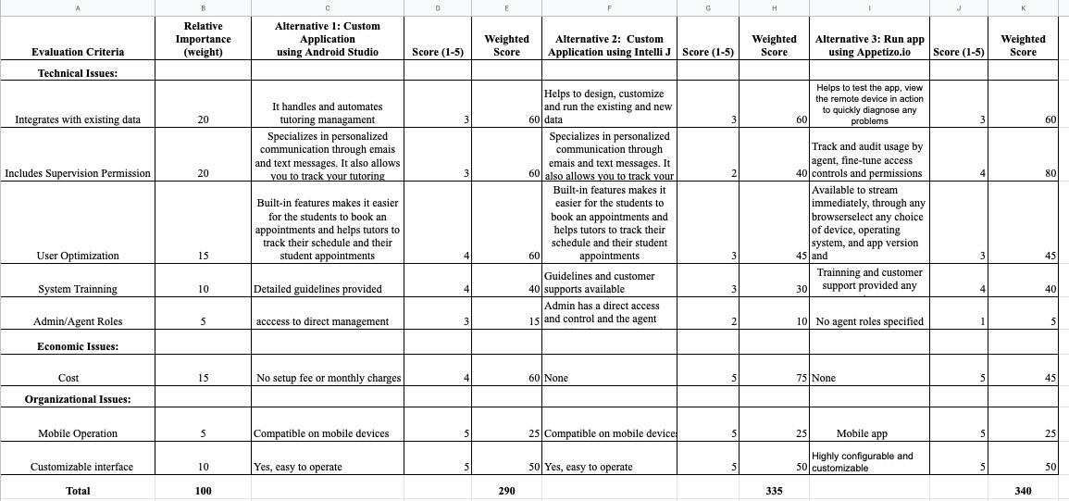
Haythem’s Alternative Matrix

Slide 8
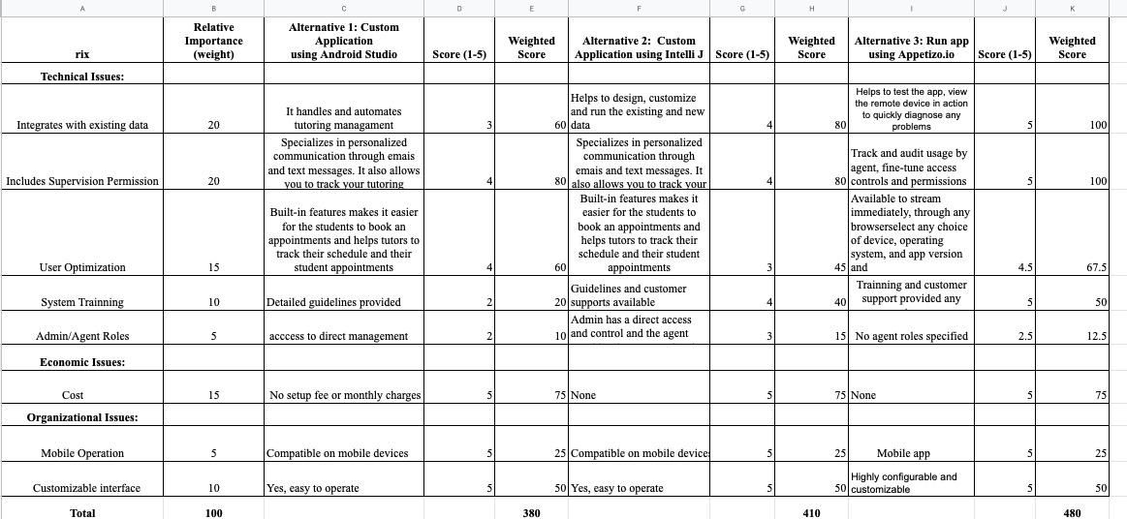
James’s Alternative Matrix

Slide 9
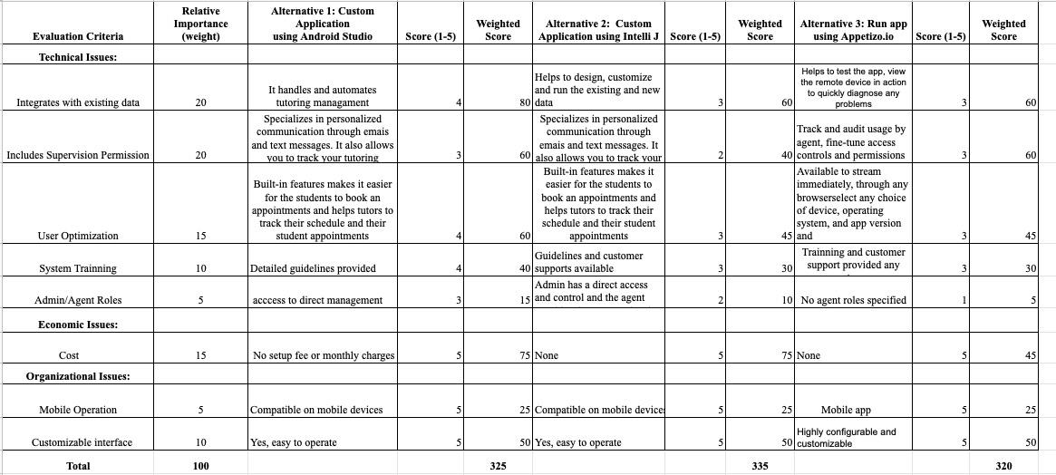
Daniel’s Alternative Matrix

Slide 10
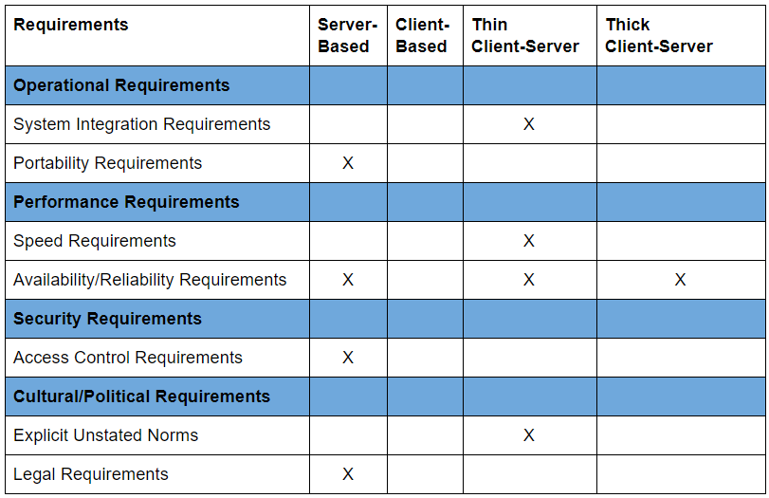
Architecture Matrix

Slide 11
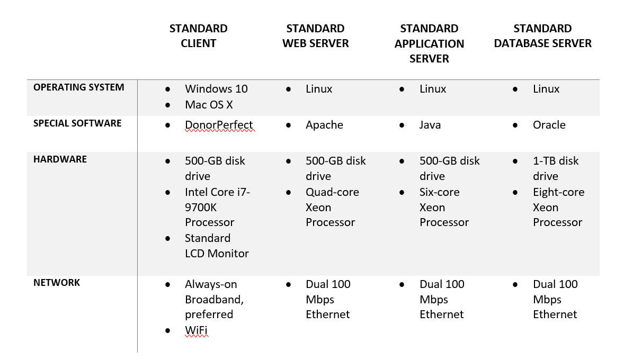
Hardware/Software Specification

Slide 12
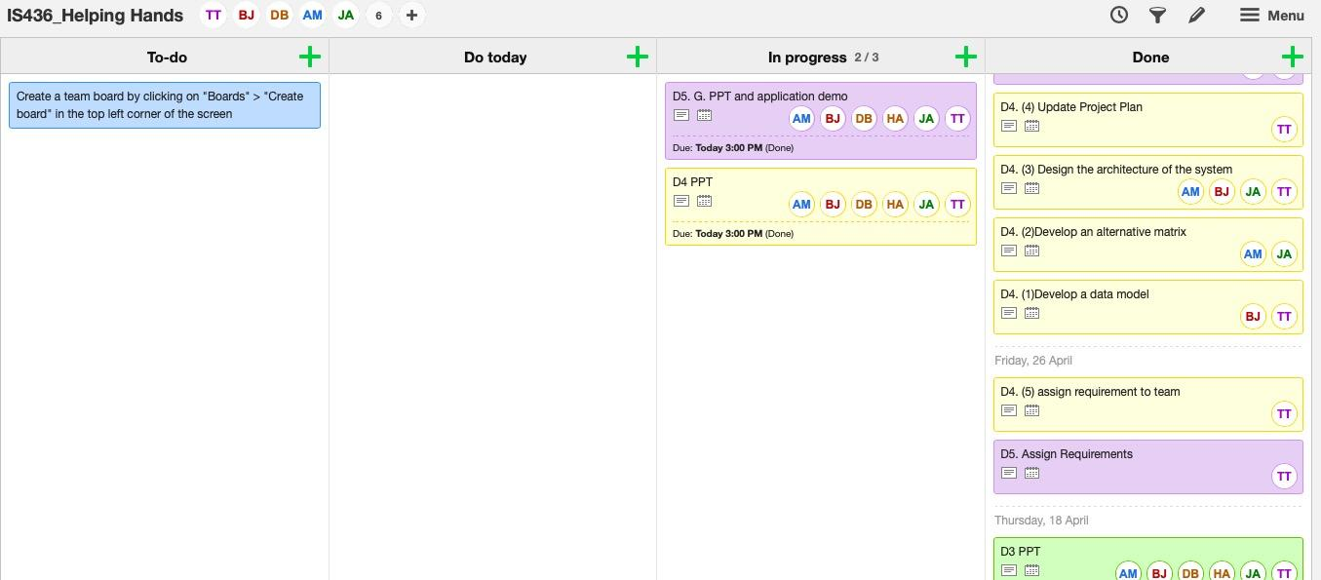
KanbanFlow

Slide 13
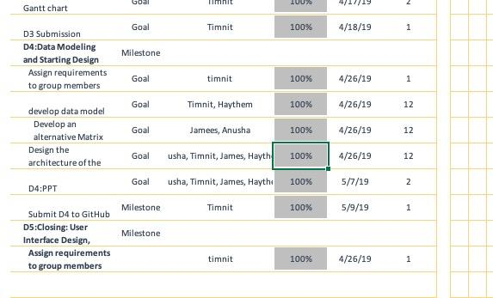
Updated Gantt Chart

Slide 14


Slide 15


